Slide 1
Transaction Management
Transaction management is ensuring the properties
of atomicity, durability, isolation, consistancy etc provided by the transaction abstraction.
In particular, isolation by means of a concept called serializability.
Several concurrency control techniques help to implement the isolation property.
Recovery management component of a database helps to implements the atomicity and durability properties.
Taken as a whole, the Transaction-management component of a database system allows application developers to focus on the implementation of individual transactions, ignoring the issues of concurrency and fault tolerance.

Slide 2
It is important that either all actions of a transaction be executed completely, or, in case of some failure, partial effects of a transaction be undone. This property is called atomicity.
Further, once a transaction is successfully executed, its effects must persist in the database—a system failure should not result in the database forgetting about a transaction that successfully completed. This property is called durability.
In a database system where multiple transactions are executing concurrently, if updates to shared data are not controlled there is potential for transactions to see inconsistent intermediate states created by updates of other transactions. Such a situation can result in erroneous updates to data stored in the database. Thus, database systems must provide mechanisms to isolate transactions from the effects of other concurrently executing transactions. This property is called isolation.

Slide 3
Concurrency Control
Lock-Based Protocols
Timestamp-Based Protocols
Deadlock Handling

Slide 4
Lock-Based Protocols
A lock is a mechanism to control concurrent access to a data item
Data items can be locked in two modes :
1. exclusive (X) mode. Data item can be both read as well as
written. X-lock is requested using lock-X instruction.
2. shared (S) mode. Data item can only be read. S-lock is
requested using lock-S instruction.
Lock requests are made to concurrency-control manager. Transaction can proceed only after request is granted.

Slide 5

Lock-Based Protocols (Cont.)
Lock-compatibility matrix
A transaction may be granted a lock on an item if the requested lock is compatible with locks already held on the item by other transactions
Any number of transactions can hold shared locks on an item,
  but if any transaction holds an exclusive lock on the item no other transaction may hold any lock on the item.
If a lock cannot be granted, the requesting transaction is made to wait till all incompatible locks held by other transactions have been released. The lock is then granted.

Slide 6
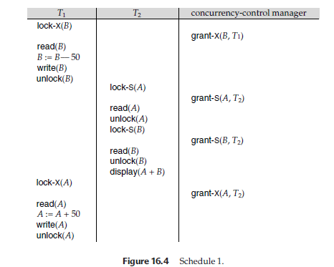
Notes:
Problems in maintaining A+B consistency..!!

Slide 7
Lock-Based Protocols (Cont.)
Example of a transaction performing locking:
T₂: lock-S(A);
read (A);
unlock(A);
lock-S(B);
read (B);
unlock(B);
display(A+B)
Locking as above is not sufficient to guarantee serializability — if A and B get updated in-between the read of A and B, the displayed sum would be wrong.
A locking protocol is a set of rules followed by all transactions while requesting and releasing locks. Locking protocols restrict the set of possible schedules.

Slide 8
Lock-Based Protocols (Cont.)
Example of unlocking delayed:
T₂: lock-S(A);
read (A);
lock-S(B);
read (B);
display(A+B)
unlock(A);
unlock(B);

Slide 9

Pitfalls of Lock-Based Protocols
Consider the partial schedule
Neither T₃ nor T₄ can make progress — executing lock-S(B) causes T₄ to wait for T₃ to release its lock on B, while executing lock-X(A) causes T₃ to wait for T₄ to release its lock on A.
Such a situation is called a deadlock.
  To handle a deadlock one of T₃ or T₄ must be rolled back
  and its locks released.

Slide 10
Pitfalls of Lock-Based Protocols (Cont.)
The potential for deadlock exists in most locking protocols. Deadlocks are a necessary evil.
Starvation is also possible if concurrency control manager is badly designed. For example:
  A transaction may be waiting for an X-lock on an item, while a sequence of other transactions request and are granted an S-lock on the same item.
  The same transaction is repeatedly rolled back due to deadlocks.
Concurrency control manager can be designed to prevent starvation.

Slide 11
The Two-Phase Locking Protocol
This is a protocol which ensures conflict-serializable schedules.
Phase 1: Growing Phase
  transaction may obtain locks
  transaction may not release locks
Phase 2: Shrinking Phase
  transaction may release locks
  transaction may not obtain locks
  The protocol assures serializability. It can be proved that the transactions can be serialized in the order of their lock points (i.e. the point where a transaction acquired its final lock).
Eg: T₂: lock-S(A);
read (A);
lock-S(B);
read (B);
display(A+B)
unlock(A);
unlock(B);

Slide 12

Partial Schedule Under Two-Phase Locking

Slide 13
The Two-Phase Locking Protocol (Cont.)
Two-phase locking does not ensure freedom from deadlocks (Eg.T3,T4)
Cascading roll-back is possible under two-phase locking. (Eg.T10,T11,T12) To avoid this, follow a modified protocol called strict two-phase locking. Here a transaction must hold all its exclusive locks till it commits/aborts.
Rigorous two-phase locking is even stricter: here all locks are held till commit/abort. In this protocol transactions can be serialized in the order in which they commit.

Slide 14
Timestamp-Based Protocols
Each transaction is issued a timestamp when it enters the system. If an old transaction T_{i} has time-stamp TS(T_{i}), a new transaction T_{j} is assigned time-stamp TS(T_{j}) such that TS(T_{i}) <TS(T_{j}).
(system clock or logical counter)
The protocol manages concurrent execution such that the time-stamps determine the serializability order.
In order to assure such behavior, the protocol maintains for each data Q two timestamp values:
  W-timestamp(Q) is the largest time-stamp of any transaction that executed write(Q) successfully.
  R-timestamp(Q) is the largest time-stamp of any transaction that executed read(Q) successfully.

Slide 15
Timestamp-Based Protocols (Cont.)
The timestamp ordering protocol ensures that any conflicting read and write operations are executed in timestamp order.
Suppose a transaction T_{i} issues a read(Q)
  If TS(T_{i}) <W-timestamp(Q), then T_{i} needs to read a value of Q that was already overwritten.
    Hence, the read operation is rejected, and T_{i} is rolled back.
  If TS(T_{i})≥ W-timestamp(Q), then the read operation is executed, and R-timestamp(Q) is set to the maximum of R-timestamp(Q) and TS(T_{i}).

Slide 16
Timestamp-Based Protocols (Cont.) ?
Suppose that transaction T_{i} issues write(Q).
  If TS(T_{i}) < R-timestamp(Q), then the value of Q that T_{i} is producing was needed previously, and the system assumed that that value would never be produced.
    Hence, the write operation is rejected, and T_{i} is rolled back.
  If TS(T_{i}) < W-timestamp(Q), then T_{i} is attempting to write an obsolete value of Q.
    Hence, this write operation is rejected, and T_{i} is rolled back.
  Otherwise, the write operation is executed, and W-timestamp(Q) is set to TS(T_{i}).
  This protocol ensures Conflict Seralizibility and Deadlock free schedule.
If a transaction Ti is rolled back by the concurrency-control scheme as result of issuance of either a read or write operation, the system assigns it a new timestamp and restarts it.

Slide 17
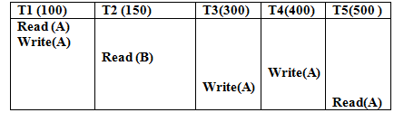
Example of Timestamp order protocol

Slide 18
Thomas’ Write Rule
Modified version of the timestamp-ordering protocol in which obsolete write operations may be ignored under certain circumstances.
When T_{i} attempts to write data item Q, if TS(T_{i}) < W-timestamp(Q), then T_{i} is attempting to write an obsolete value of {Q}.
  Rather than rolling back T_{i} as the timestamp ordering protocol would have done, this {write} operation can be ignored.
Otherwise this protocol is the same as the timestamp ordering protocol.
Thomas' Write Rule allows greater potential concurrency.
  Allows some view-serializable schedules that are not conflict-serializable.

Slide 19
Correctness of Timestamp-Ordering Protocol
The timestamp-ordering protocol guarantees serializability since all the arcs in the precedence graph are of the form:
Thus, there will be no cycles in the precedence graph
Timestamp protocol ensures freedom from deadlock as no transaction ever waits.
But the schedule may not be cascade-free, and may not even be recoverable.
transaction
with smaller
timestamp
transaction
with larger
timestamp

Slide 20
University Paper Question
1.Define Transaction Management. Explain ACID
propertiies with example(4)
2. Write a short note on Deadlock in Database (4)
3.Explain 2 phase locking protocol with example (1)
4.Short note on 2 phase locking protocol (2)
5.Explain lock-based protocol to control concurrency in Database(4).
6.Explain in brief 2 phase locking protocol (6)
7.Explain Timestamp based concurrency control protocol (1)

Slide 21
Recovery Schemes
Recovery schemes are techniques to ensure database consistency and transaction atomicity and durability despite failures such as transaction failures, system crashes, disk failures.
Recovery algorithms have two parts
  Actions taken during normal transaction processing to ensure enough information exists to recover from failures
  Actions taken after a failure to recover the database contents to a state that ensures atomicity, consistency and durability

Slide 22
Recovery and Atomicity
Modifying the database without ensuring that the transaction commits may leave the database in an inconsistent state.
  Consider again the transaction T_{i} that transfers €50 from account A to account B.
  Several output operations are required for T_{i} (to output A and B). A failure may occur after one of these modifications have been made but before all of them are made.

Slide 23
Example of Data Access
buffer
Buffer Block A
input(A)
X
A
Buffer Block B
Y
B
output(B)
read(X)
x₁
y₁
work area
of T₁
memory
disk

Slide 24
Recovery and Atomicity
To ensure atomicity despite failures, first output information describing the modifications to stable storage (i.e. storage guaranteed/assumed not to fail, without modifying the database itself.
Two approaches are possible:
  1.Log-based recovery, and
  2.Shadow-paging

Slide 25
Log-Based Recovery
A log is kept on stable storage.
  The log is a sequence of log records, and maintains a record of update activities on the database.
When transaction T_{i} starts, it registers itself by writing a
<T_{i} start>log record
Before T_{i} executes write(X), a log record <T_{i}, X, V₁, V₂> is written, where V₁ is the value of X before the write, and V₂ is the value to be written to X.
  Log record notes that T_{i} has performed a write on data item X_{j} X_{j} had value V₁ before the write, and will have value V₂ after the write.
When T_{i} finishes it last statement, the log record <T_{i} commit> is written.
For writing the actual records
  Deferred database modification
  Immediate database modification

Slide 26
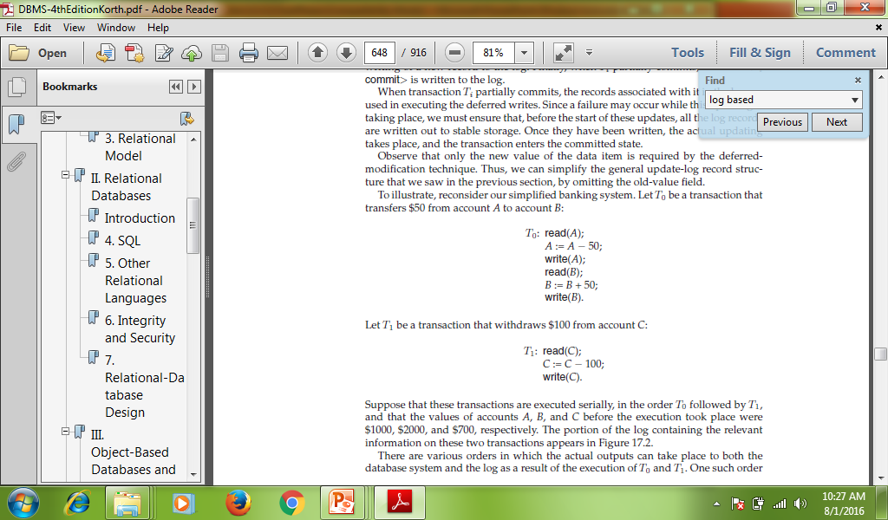

Slide 27
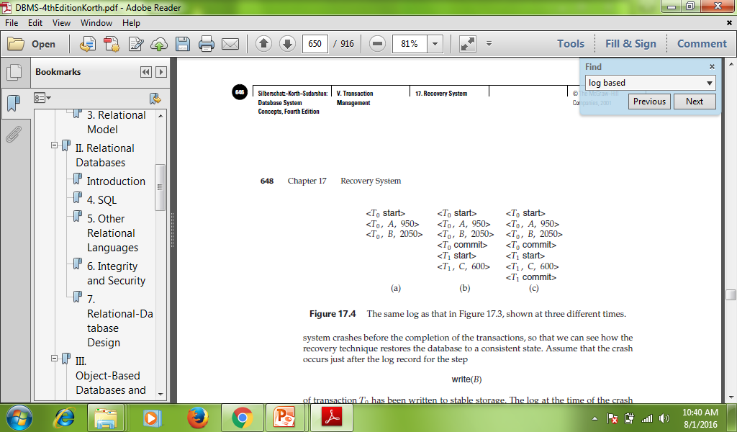

Slide 28
Deferred Database Modification
The deferred database modification scheme records all modifications to the log, and defers writes to after partial commit.
Transaction starts by writing <T_{i} start> record to log.
A write(X) operation results in a log record <T_{i}, X, V> being written, where V is the new value for X (old value is not needed).
  The write is not performed on X at this time, but is deferred.
When T_{i} partially commits, <T_{i} commit> is written to the log
After that, the log records are read and used to actually execute the previously deferred writes.
During recovery after a crash, a transaction needs to be redone if and only if both <T_{i} start> and<T_{i} commit> are there in the log.
Redoing a transaction T_{i} ( redoT_{i}) sets the value of all data items updated by the transaction to the new values.

Slide 29
Immediate Database Modification
The immediate database modification scheme allows database updates of an uncommitted transaction to be made as the writes are issued
  since undoing may be needed, update logs must have both old value and new value
Update log record must be written before database item is written
  We assume that the log record is output directly to stable storage
  Can be extended to postpone log record output, so long as prior to execution of an output(B) operation for a data block B, all log records corresponding to items B must be flushed to stable storage
Output of updated blocks can take place at any time before or after transaction commit
Order in which blocks are output can be different from the order in which they are written.

Slide 30
Immediate Database Modification Example
Log Write Output
<T₀ start>
<T₀, A, 1000, 950>
<T_{o}, B, 2000, 2050>
A = 950
B = 2050
<T₀ commit>
<T₁ start>
<T₁, C, 700, 600>
C = 600
B_{B} , B_{C}
<T₁ commit>
B_{A}
Note: B_{X} denotes block containing X.
B_{C} output before T₁ commits
B_{A} output after T₀ commits

Slide 31
Immediate Database Modification (Cont.)
Recovery procedure has two operations instead of one:
  undo(T_{i}) restores the value of all data items updated by T_{i} to their old values, going backwards from the last log record for T_{i}
  redo(T_{i}) sets the value of all data items updated by T_{i} to the new values, going forward from the first log record for T_{i}
Both operations must be idempotent
  That is, even if the operation is executed multiple times the effect is the same as if it is executed once
    Needed since operations may get re-executed during recovery
When recovering after failure:
  Transaction T_{i} needs to be undone if the log contains the record
  <T_{i} start>, but does not contain the record <T_{i} commit>.
  Transaction T_{i} needs to be redone if the log contains both the record <T_{i} start> and the record <T_{i} commit>.
Undo operations are performed first, then redo operations.

Slide 32
Checkpoints
Problems in recovery procedure as discussed earlier :
  searching the entire log is time-consuming
  one might unnecessarily redo transactions which have already output their updates to the database.
Streamline recovery procedure by periodically performing checkpointing
  Output all log records currently residing in main memory onto stable storage.
  Output all modified buffer blocks to the disk.
  Write a log record < checkpoint> onto stable storage.

Slide 33
University Paper Questions
Write a short note on Log Based recovery (5)
Explain different concurrency control protocols in database management systems (3)
Explain the need for concurrency control in transaction management.(5)

